Slide 1
CLASS OF 2027
Scheduling for 2024-2025

Slide 2
Promotion & Graduation
9th-10th Promotion
6 credits
1 in English
1 in Math
4 additional credits
No Promotion=No Driver’s Ed
Graduation Requirements
4 English
4 Math
3 Science (must take Biology)
3 Social Studies (must take US)
1 Physical Education
.5 Health
3 Career Pathway
2 World Language
5.5 Electives
26 Total Credits

Slide 3
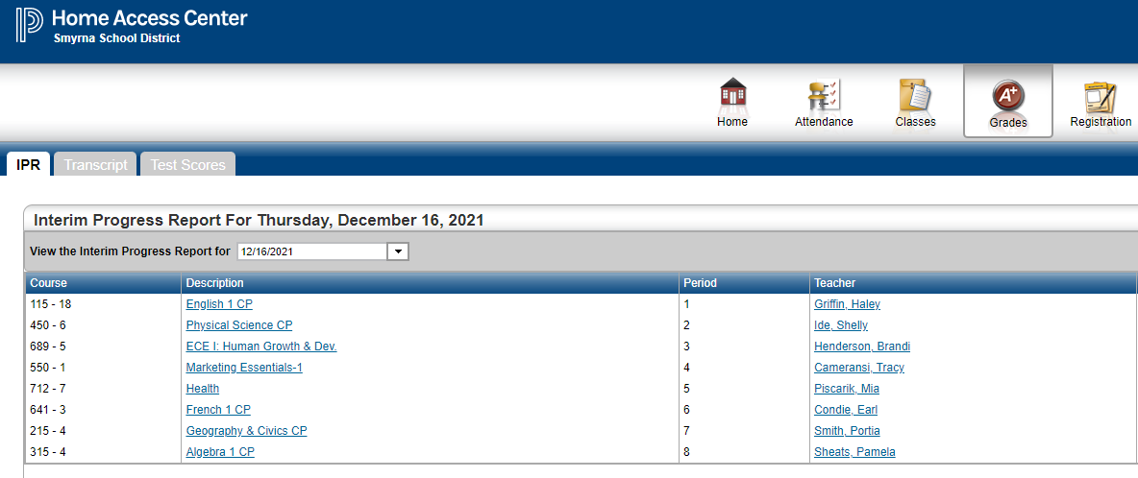
Open Home Access Grades

Slide 4
Choose Current Course Levels
Circle each Core Course Level for each Core Subject
English
Math
Science
Social Studies

Slide 5
Choose Next Year’s Course Levels
Follow the row & circle Core Subject for Next year
English
Math
Science
Social Studies

Slide 6
Interested in a challenge?
For an Honors/AP course next school year, it is recommended that students have a final grade of at least a B- in their current Honors course in that subject area OR a final grade of at least an A- if they currently are taking a CP course.

Slide 7
You need to select:
1 English
1 Math
1 Science
1 Social Studies
Driver Education (select based on birthdate)
Phys. Education 2 (or PE 1 if you haven’t taken PE 1)
3 Electives: Pathway, World Language, 1 other elective

Slide 8
You must select 4 alternate courses:
Alternate courses are classes you wouldn’t mind taking if we cannot fit your 1st requests into your schedule (example: if there is a conflict because 2 classes you selected are offered at the same time).

Slide 9
Some courses are more popular than others
Art, Culinary, Ag Structures, Ag Power, ECE/K12, Allied Health
It is likely that you will end up with a class that you selected as an alternate.
PE class should be taken in order (PE I then PE II)
Career pathway classes are difficult to change after your Sophomore year so choose wisely now.

Slide 10
Select “Classes” & then click on the “Requests” tab

Slide 11
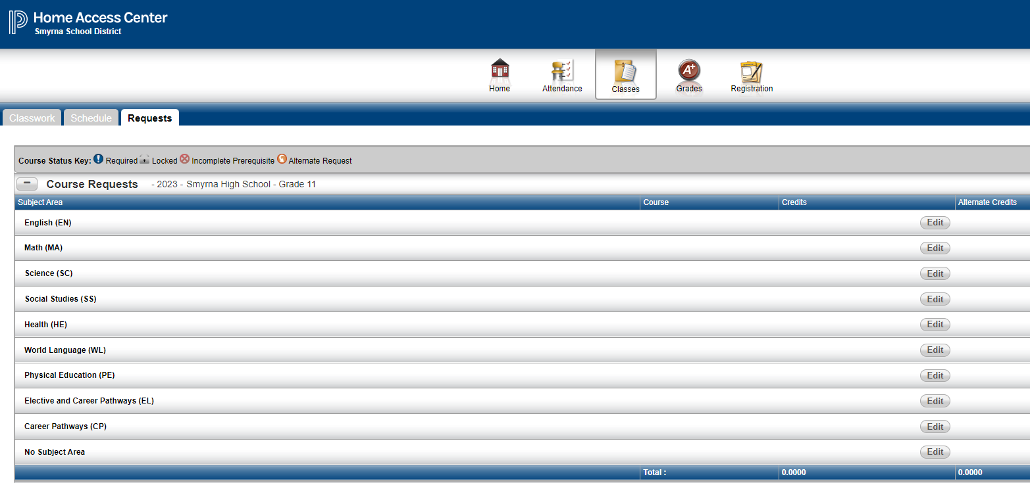
*Your Screen Should Look Like This. Click on the “Edit” button next to the subject area to select a course.

Slide 12
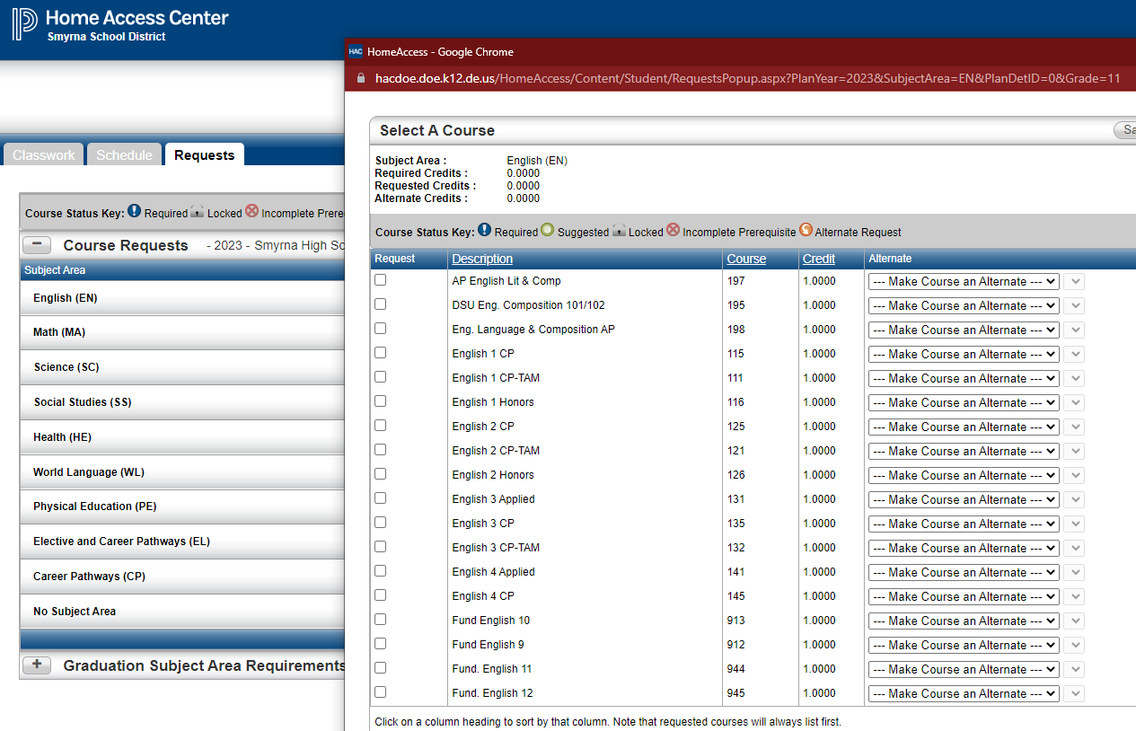
GRADUATION REQUIREMENTS
This box will show up on your screen. Click on the box to the left of the course you want to select.

Slide 13
Selecting an Alternate Course: Click on the box to the left of the course. In the drop-down, you should select: “Alternate to Any Course”

Slide 14
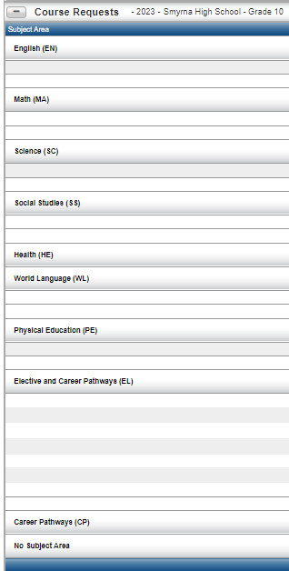
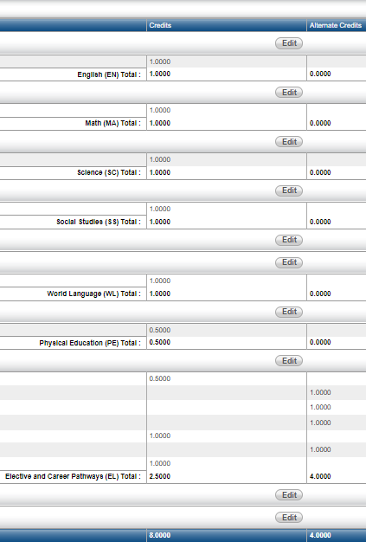
Summary Screen
Orange Circle w/arrow=Alternate
Total Request: 8 Total Alternates: 4

